Slide 1
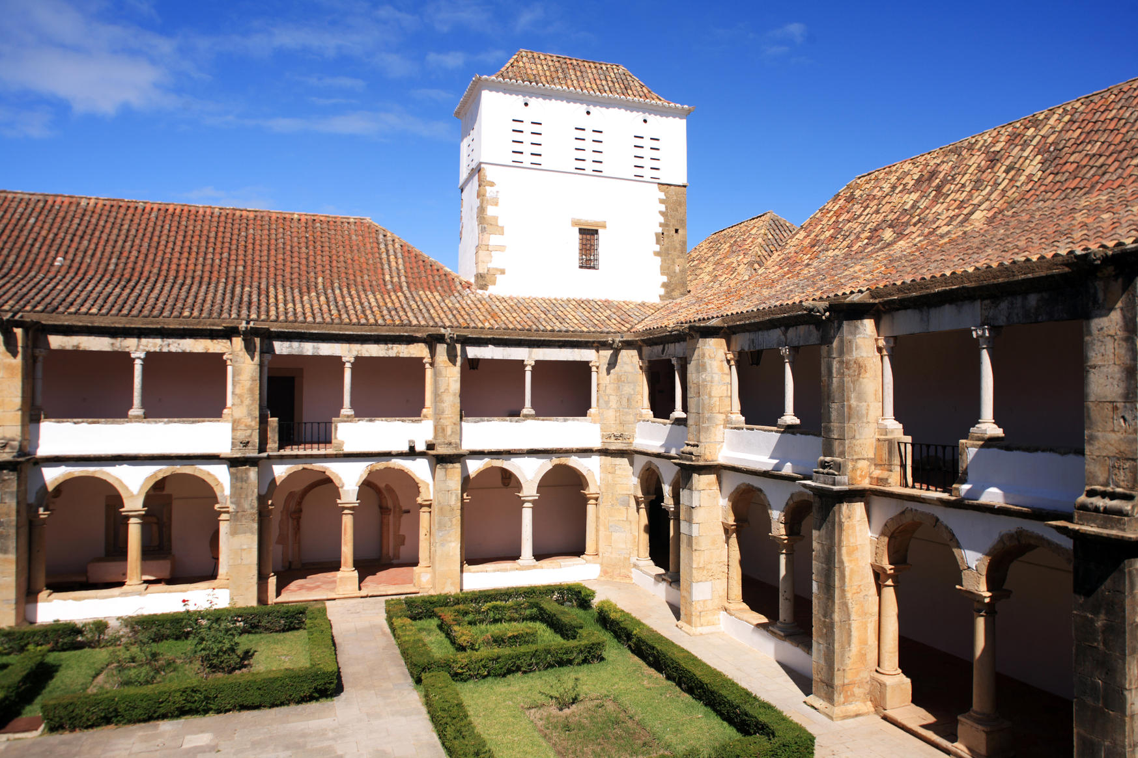
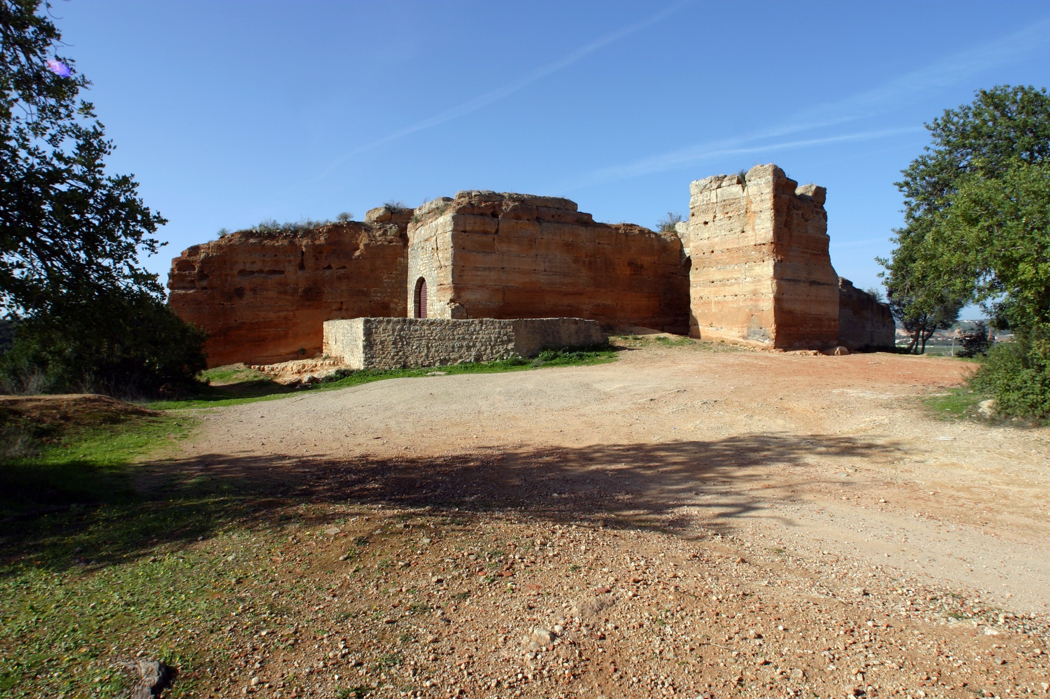
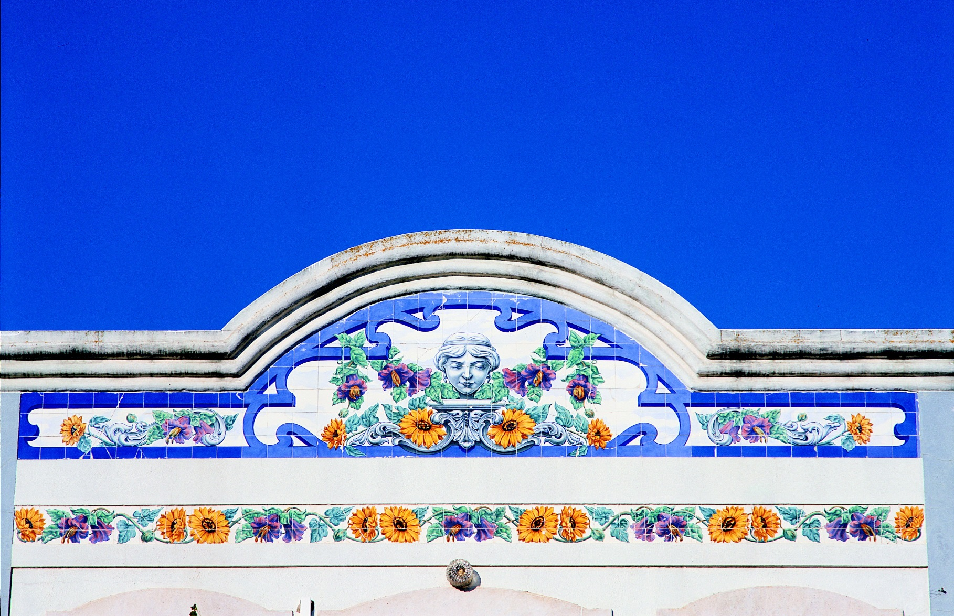
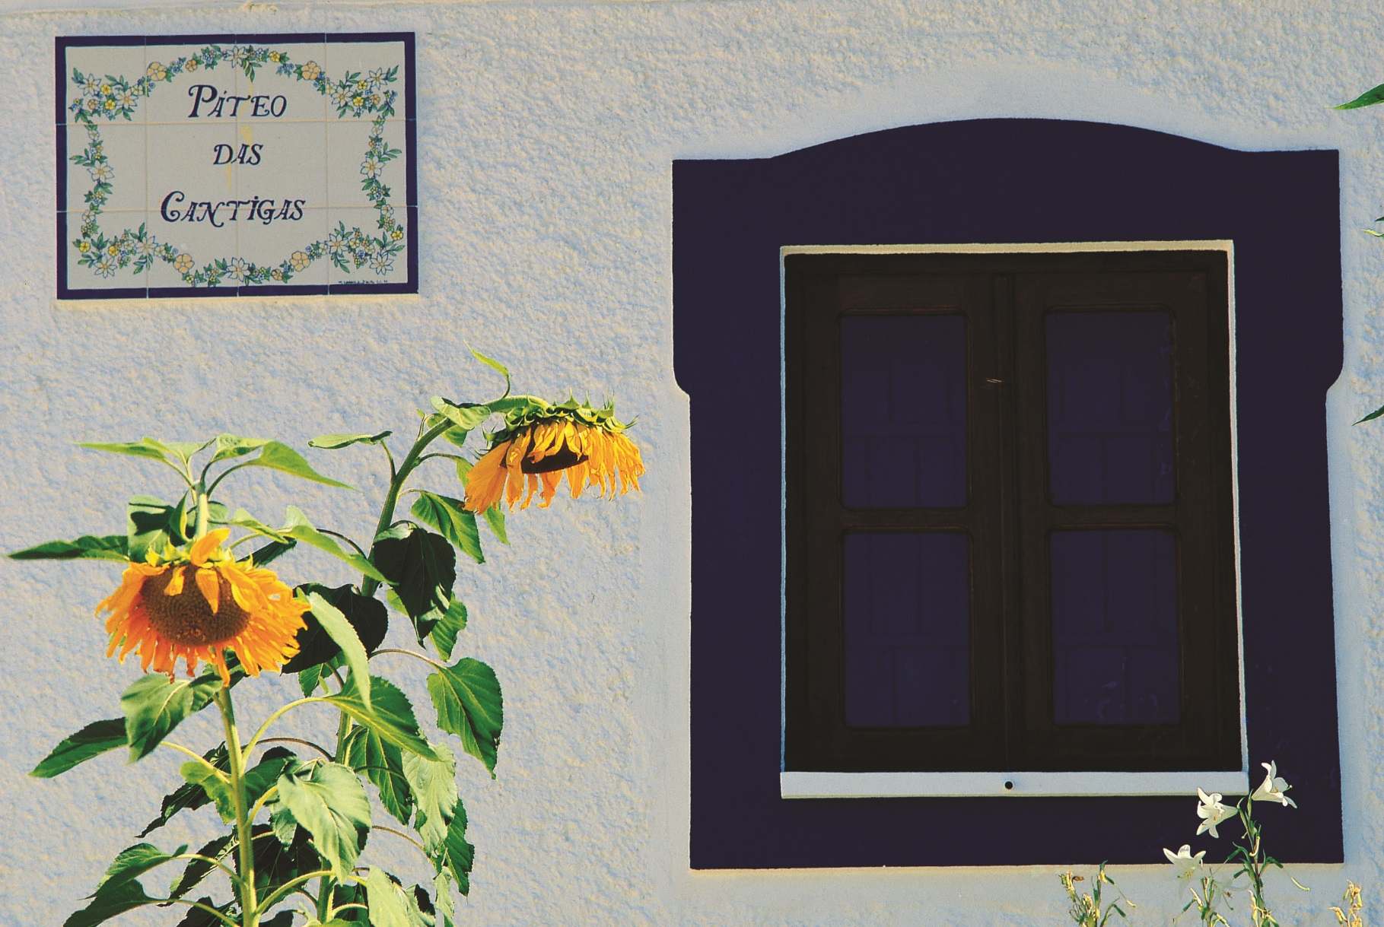
Poster Title (Arial, bold, 48 pt, max. 70 characters, including spaces)
First Author | contact1@email.com (Arial, normal, 32 pt)
Supervisor(s)/other | contact2@email.com (Arial, normal, 32 pt)
Motivation and Objectives
R&D - MSc thesis, young researchers program
Description of the main objectives
(Arial, 40 pt, max. 200 characters, including spaces)
Methodology
Concrete formulation with high content of fly ashes
Structural light weight concrete
Self compacting concrete
(Arial, 40 pt, max. 200 characters, including spaces)
Discussion of Results
Compatible mortars for conservation interventions
Repair mortars for reinforced concrete structures
Inspection and diagnosis
(Arial, 40 pt, max. 200 characters, including spaces)
Main Conclusions
Compatible mortars for conservation interventions
Acknowledgements
(Arial, 40 pt, max. 200 characters, including spaces)
References
Xxxx
Xxxx
Xxxx
(Arial, 40 pt, max. 200 characters, including spaces)

